Slide 1
Cloud One™ File Storage Security
Markus Winkler
Cloud & DevOps Architect
Notes:
Widening the Gap
Raising the Bar for the Cloud competition
Extending our Leadership
#1 for Reason – addressing more customer leads for a reason

Slide 2
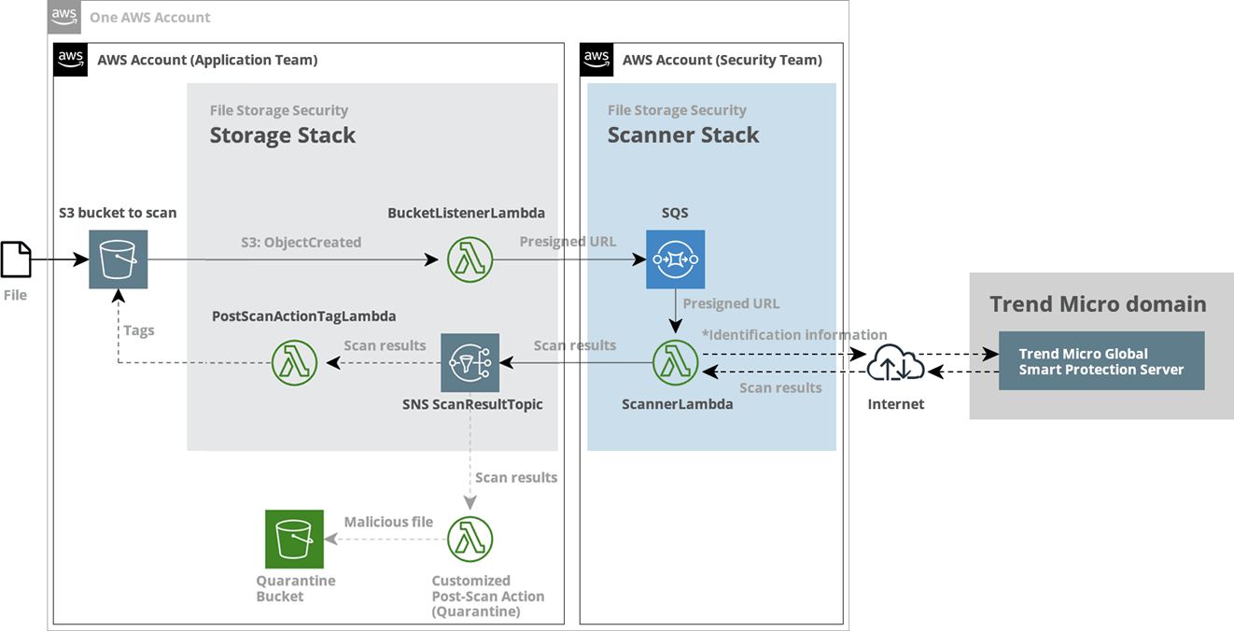
Architecture

Slide 3
Performance
Below are some estimates of how long a scan takes for various file types:
EXE file under 100 MB: 4 seconds
BIN file under 100 MB: 4 seconds
JPEG file under 40 MB: 3 seconds
MP4 file under 1600 MB: 3 seconds
PDF file under 1500 MB: 22 seconds
TXT file under 100 MB: 4 seconds
ZIP file under 100 MB: 5 seconds
The data was collected by uploading individual sample files to an S3 bucket that was in the same region as the scanner. The estimates assume that 512 MB of memory (the default) has been allocated to the File Storage Security scanner

